Slide 1
Build your In Demand Skills
Care Coordination Training

Slide 2
What is Care Coordination?
Care coordination is a very rewarding and fast-growing career in the health care industry.
Care coordination is all about health care professionals working together to ensure that patients’ health needs are being met and that the right care is being delivered in the right place, at the right time, and by the right person.

Slide 3
Roles of Care Coordination

Slide 4
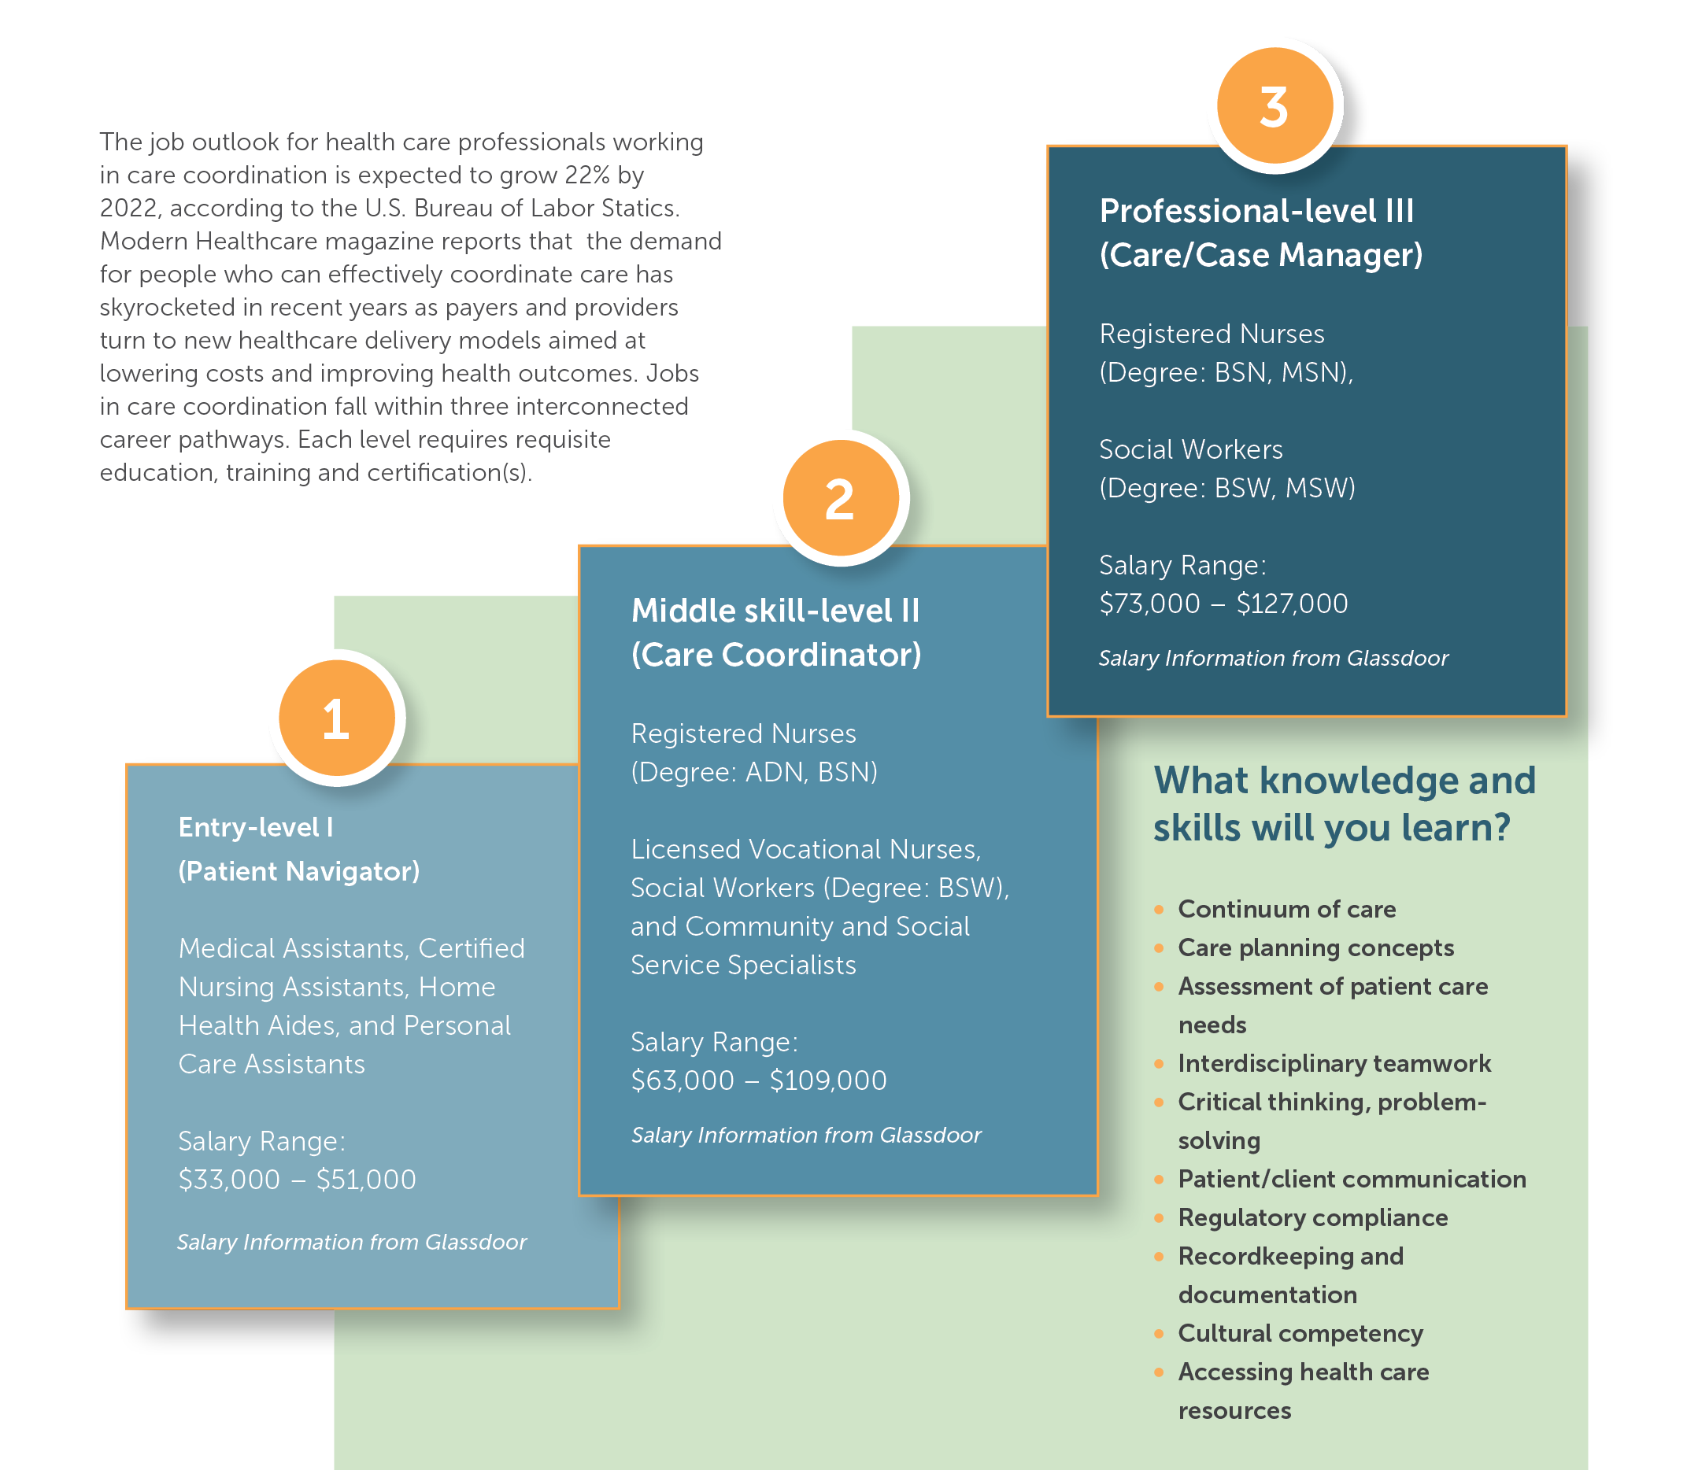
What Jobs, Career Pathways & Salaries are Available?
The job outlook for health care professionals working in care coordination is expected to grow 22% by 2022, according to the U.S. Bureau of Labor Statics.
Modern Healthcare magazine reports that the demand for people who can effectively coordinate care has skyrocketed in recent years as payers and providers turn to new healthcare delivery models aimed at lowering costs and improving health outcomes.

Slide 5
What Skills Will You Learn?
Strong Organizational Skills
Records Accuracy
Interpersonal Skills
Collaboration
Teamwork
Written Communications
Verbal Communications
IT Proficiency
Knowledge
Overcoming Barriers
Project Management

Slide 6
What Skills Will You Learn?

Slide 7
Next Steps
(Partner to insert next steps here based on interest level
Partner to insert logo
Contact information
Website

